Slide 1
Introduction
to
Deep Learning

Slide 2
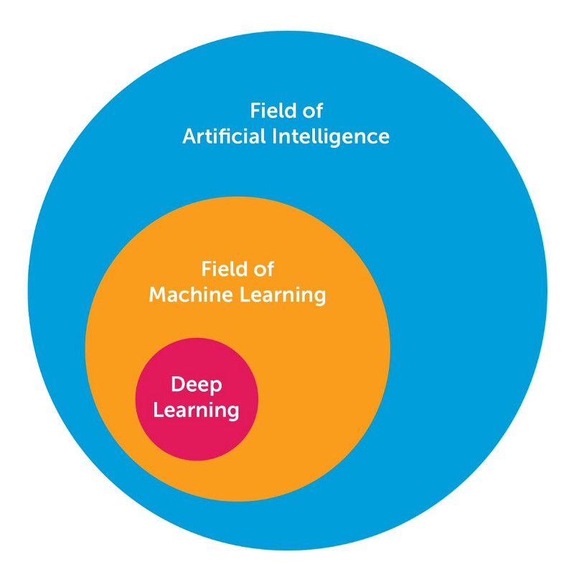
Introduction
AI, ML and DL
Source: [1]

Slide 3
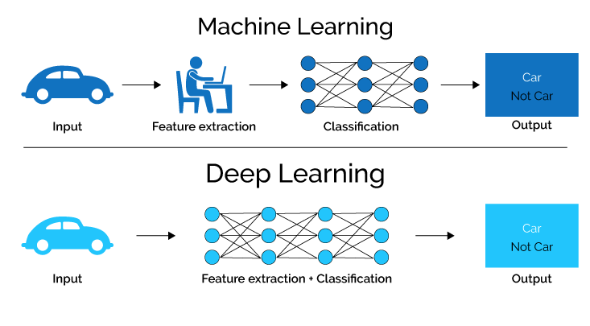
Introduction
Machine Learning vs Deep Learning
Source: [2]

Slide 4
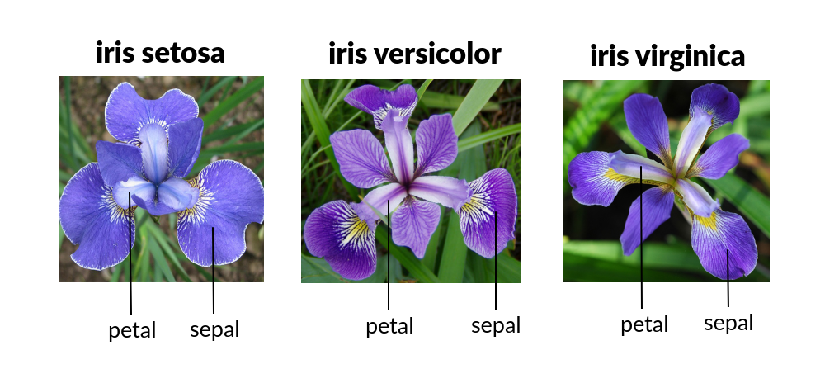
Introduction
Machine Learning vs Deep Learning
Source of the Image: https://editor.analyticsvidhya.com/uploads/51518iris%20img1.png

Slide 5
Major Architectures of Deep Networks
Four Major Architectures:
Unsupervised Pretrained Networks (UPNs)
Convolutional Neural Networks (CNNs)
Recurrent Neural Networks
Recursive Neural Networks

Slide 6
Major Architectures of Deep Networks
Four Major Architectures:
Unsupervised Pretrained Networks (UPNs)
Autoencoders
Deep Belief Networks (DBNs)
Generative Adversarial Networks (GANs)
Use Cases:
Feature Extraction
Synthesizing
Source: [3]

Slide 7
Unsupervised Pretrained Networks
The neural network architecture which are based on pretrained learning.
Unsupervised pre-training is a machine learning technique where a model is trained on a large dataset without any labeled data. This allows the model to learn useful features or representations of the data that can then be used for a downstream task with labeled data.
For example, a model trained on a large corpus of text can learn useful representations of the text that can then be fine-tuned for a specific text classification task.

Slide 8
Autoencoders
Autoencoders are self-supervised machine learning models which are used to reduce the size of input data by recreating it. These models are trained as supervised machine learning models and during inference, they work as unsupervised models that’s why they are called self-supervised models. Autoencoder is made up of two components:
Encoder- It works as a compression unit that compresses the input data.
Decoder-It decompresses the compressed input by reconstructing it.

Slide 9
Applications of Autoencoder
File Compression
Image De-noising
Image transformation

Slide 10
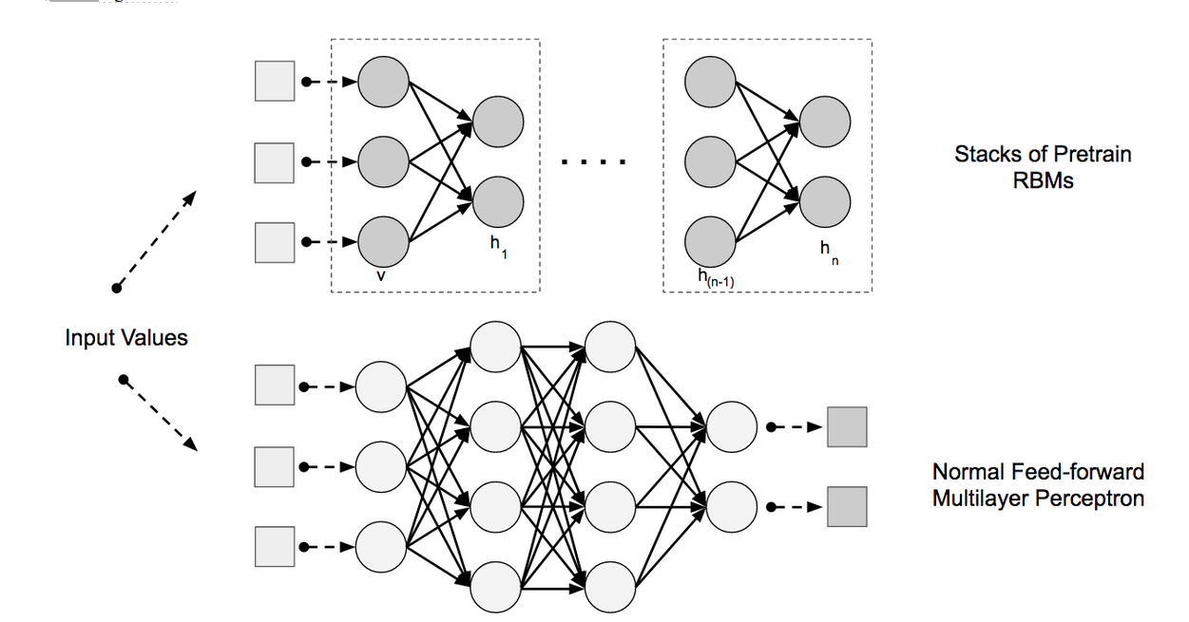
Deep Belief Networks
DBNs are composed of layers of Restricted Boltzmann Machines (RBMs) for the pretrain phase and then a feed-forward network for the fine-tune phase. RBM are used for extraction of high level feature vectors.

Slide 11
Generative Adverasial Network
GANs have been shown to be quite adept at synthesizing novel new images based on other training images. We can extend this concept to model other domains such as the following:
Sound
Video
Generating images from text descriptions

Slide 12
Contd…
GANs are an example of a network that uses unsupervised learning to train two models in parallel. A key aspect of GANs (and generative models in general) is how they use a parameter count that is significantly smaller than normal with respect to the amount of data on which we’re training the network. The network is forced to efficiently represent the training data, making it more effective at generating data similar to the training data.

Slide 13
Major Architectures of Deep Networks
Four Major Architectures:
Convolutional Neural Networks (CNNs)
Lenet-5
AlexNet
VGGNet
GoogleNet (Inception)
ResNet
ResNext
DenseNet
RCNN (Region Based CNN)
YOLO (You Only Look Once)
SqueezeNet
SegNet

Slide 14
Convolutional Neural Network
The goal of CNN is to learn high order features in the data via convolution.
Convolution is a specialized kind of linear operation. Convnets are simply neural networks that use convolution in place of general matrix multiplication in at least one of their layers.
Convolution between two functions in mathematics produces a third function expressing how the shape of one function is modified by other

Slide 15
Working of Convolution Function
It uses a matrix known as kernel for the convolution operation.
A kernel maps on the input image by simple matrix multiplication and addition, the output obtained is of lower dimensions and therefore easier to work with.

Slide 16
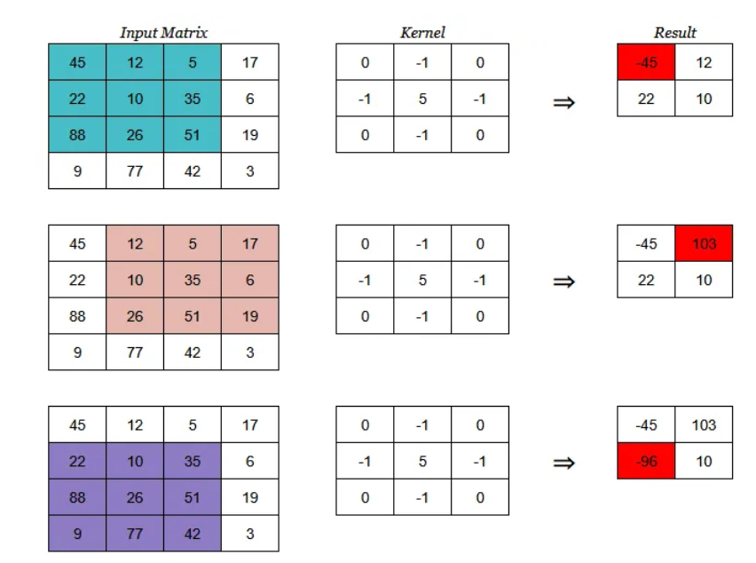
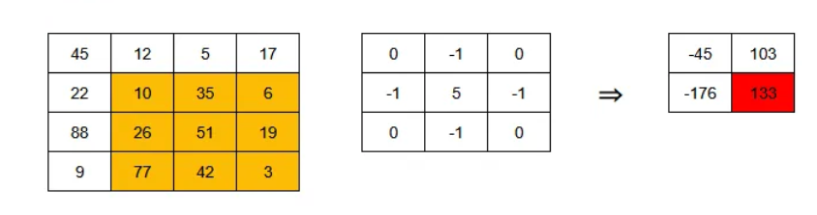
Example of Convolution

Slide 17
CNN
It consists of three layers:
Input layer-The input layer accepts three-dimensional input generally in the form spatially of the size (width × height) of the image and has a depth representing the color channels.
Feature extraction layer- which is further composed of two layers
Convolutional layer- It performs the convolution operation on the input and reduce it to lower dimensions.
Pooling layer- These layers find a number of features in the images and progressively construct higher-order features.

Slide 18
Major Architectures of Deep Networks
Four Major Architectures:
Convolutional Neural Networks (CNNs)
Use Cases:
Computer Vision
Natural Language Processing

Slide 19
Major Architectures of Deep Networks
Four Major Architectures:
Recurrent Neural Networks- A Recurrent Neural Network includes a feedback loop that it uses to learn from sequences, including sequences of varying lengths. Recurrent Neural Networks contain an extra parameter matrix for the connections between time-steps, which are used/trained to capture the temporal relationships in the data.
Hopfield Network
Long Short-Term Memory (LSTM)
Gated Recurrent Unit (GRU)
Use Cases:
Sentiment Classification
Image Captioning
Language Translation
Video Captioning

Slide 20
Major Architectures of Deep Networks
Four Major Architectures:
Recursive Neural Networks- Recursive Neural Networks, like Recurrent Neural Networks, can deal with variable length input. The primary difference is that Recurrent Neural Networks have the ability to model the hierarchical structures in the training dataset. Images commonly have a scene composed of many objects. Deconstructing scenes is often a problem domain of interest yet is nontrivial. The recursive nature of this deconstruction challenges us to not only identify the objects in the scene, but also how the objects relate to form the scene. A Recursive Neural Network architecture is composed of a shared-weight matrix and a binary tree structure that allows the recursive network to learn varying sequences of words or parts of an image.
Recursive Autoencoder
Recursive Neural Tensor Network

Slide 21
Use Cases
Use Cases:
Image scene decomposition
NLP
Audio-to-text transcription

Slide 22
References
https://towardsdatascience.com/the-10-deep-learning-methods-ai-practitioners-need-to-apply-885259f402c1
2. https://semiengineering.com/deep-learning-spreads/
3. https://www.safaribooksonline.com/library/view/deep-learning/9781491924570/ch04.html

Slide 23
Disclaimer
Content of this presentation is not original and it has been prepared from various sources for teaching purpose.

